Slide 1

Remote Debugging Detection in Android
Graduand Mirco Venerba
Matriculation Number 872653
Supervisor Prof. Paolo Falcarin
Master’s Degree programme in Computer Science
Academic Year 2022-2023

Slide 2
Presentation overview
Introduction to the problem
Possible solution
Software architecture
Types of logs
Validation and testing
Future developments
13/07/2023
Mirco Venerba – Remote debugging detection in Android
0

Slide 3


What is the problem?
Store sensitive information
Analysis and tampering apps
13/07/2023
Mirco Venerba – Remote debugging detection in Android
1
Notes:
Inserire immagini per fare introduzione security mate attacks

Slide 4
How can this happen?
13/07/2023
Mirco Venerba – Remote debugging detection in Android
2

Slide 5



Man-At-The-End (MATE) Attacks
Renew
attacks
Monitor
attacks
Target
Program
Defender
Attacker
Types of attacks:
Debugger
Emulator
Disassembler
Decompiler
Virtual machine
Tracer
Analyse
defenses
Types of tampering:
Modify functionality
Remove functionality
Remove licenses
Remove protections
Renew
defenses
Types of defenses:
Emulator detection
Debugger detection
Obfuscation
Tamper proofing
Cryptography
Code renewability
13/07/2023
Mirco Venerba – Remote debugging detection in Android
3
Notes:
Inserire immagini per fare introduzione security mate attacks

Slide 6
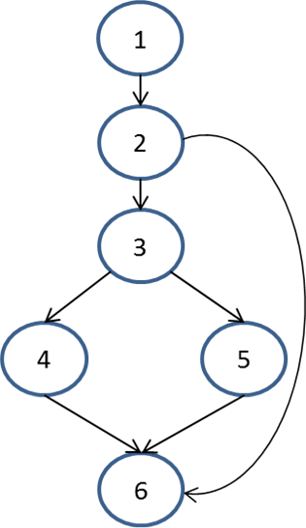
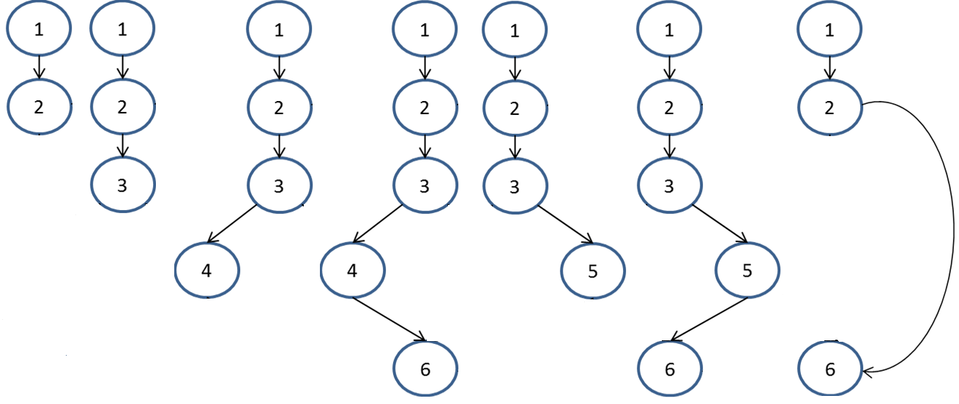
Incremental executions attacks
Target program
Incremental executions
13/07/2023
Mirco Venerba – Remote debugging detection in Android
4
Notes:
Inserire immagini per fare introduzione security mate attacks

Slide 7
What is our goal?
Novel way to detect mate attacks on the device before they are carried out
13/07/2023
Mirco Venerba – Remote debugging detection in Android
5

Slide 8
What is a possible solution?
13/07/2023
Mirco Venerba – Remote debugging detection in Android
6

Slide 9


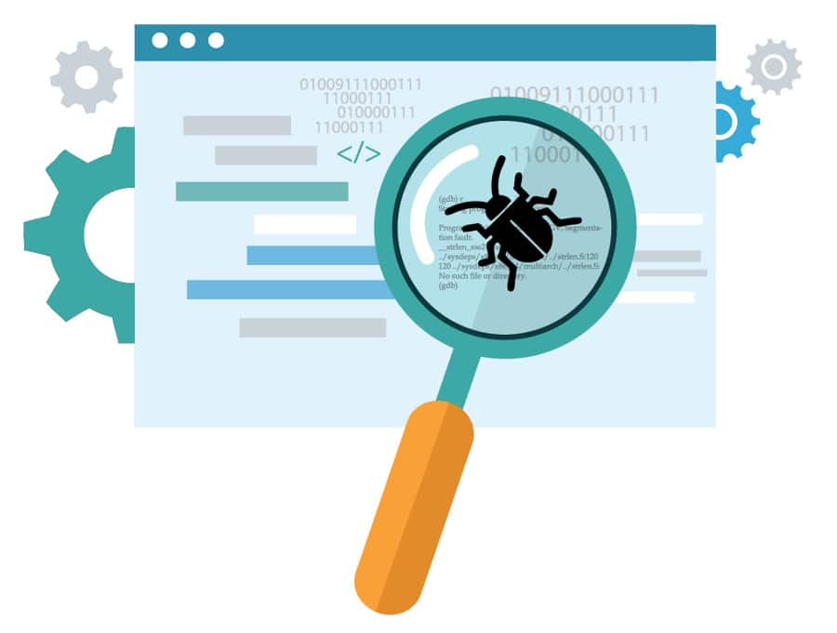

Components of the process
Data
mining
Anomaly
detection
Debugger
detection
Security
level
13/07/2023
Mirco Venerba – Remote debugging detection in Android
7

Slide 10

What types of data are useful?
High level information:
connected real debuggers
Medium level information:
sensors data, sensors alerts, settings, recharge type, debuggable applications, application state in lifecycle
Low level information:
duration of syscall, sequences of syscall, incremental executions path
13/07/2023
Mirco Venerba – Remote debugging detection in Android
8
Notes:
Semplifiicare e foto

Slide 11
Why exactly these information?
13/07/2023
Mirco Venerba – Remote debugging detection in Android
9

Slide 12


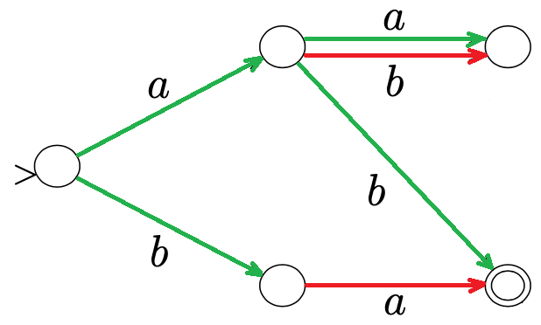
Some suspicious cases
Stationary device
USB connection
Wrong syscall sequences
13/07/2023
Mirco Venerba – Remote debugging detection in Android
10

Slide 13
Software architecture
13/07/2023
Mirco Venerba – Remote debugging detection in Android
11

Slide 14
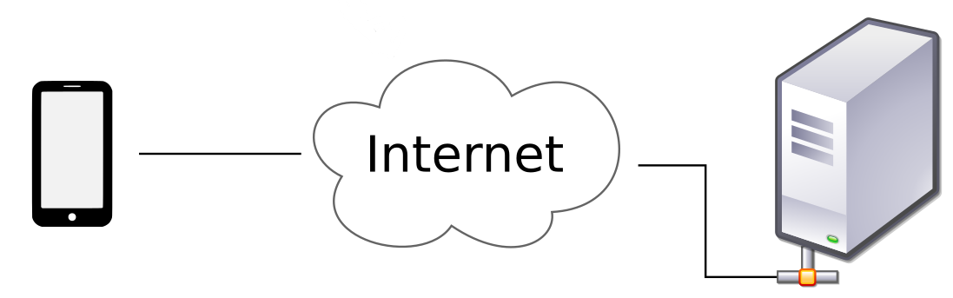

Architecture description
Device
Server
Low level
library
High level
library
13/07/2023
Mirco Venerba – Remote debugging detection in Android
12
Notes:
Blocchi attaccati a device grafica

Slide 15
Components description
Server (Python): sensors alerts, statistics of system calls, instruction sequences,
incremental execution paths, calculation of device alert level
Low level library (C++): thesis project of another student extended with many different analysis of system calls and their sequences
High level library (JAVA): debuggers, sensors data, settings, recharge type,
debuggable applications
13/07/2023
Mirco Venerba – Remote debugging detection in Android
13
Notes:
Blocchi attaccati a device grafica

Slide 16
Types of execution logs
13/07/2023
Mirco Venerba – Remote debugging detection in Android
14

Slide 17
C++ library logs
Syscall started
Syscall finished
------------------ SYSCALL ENTRY START ------------------
Notification origin: it.mircovenerba.audiorecorder
PID: 14711 SPID: 14711
Timestamp: 1673561963897680
Syscall = ioctl (29)
Stack unwinding = {
PC 0x000079d54b34d8 … - startRecording(..)
PC 0x000079d546f2f4 … - talkWithDriver(..)
PC 0x000079ca76e7ac … - main(..) ……}
Parameters = {
0x000000000000003c
0x00000000c0306201
0x0000007fcfedfb68…}
Registers = {
PC: 0x00000079d54b34d8
SP: 0x0000007fcfedfa50
RET: 0x000000000000003c…}
------------------ SYSCALL ENTRY STOP ------------------
------------------ SYSCALL EXIT START ------------------
PID: 18480
SPID: 18480
Timestamp: 1684069975351329
Return value: 000000000000000000
------------------ SYSCALL EXIT STOP ------------------
Types of extracted data for each syscall
timing
system call number
stack trace
parameters
cpu registers
13/07/2023
Mirco Venerba – Remote debugging detection in Android
15

Slide 18
Java library logs – first part
Debuggable applications
Recharge type
Developer options
Debuggable flag enabled in the manifest file
Check when the recharge type is USB
Check if they are enabled
LIST OF DEBUGGABLE APPLICATIONS
Application
Name: AudioRecorder
Application
Name: Progetto Android
LIST OF CHARGING RECORDS
Charging record
Is charging: True
Usb charging: True
Ac charging: False
Start timestamp: 1684070992389
Finish timestamp: 17893546284049
Charging record
Is charging: False
Usb charging: False
Ac charging: False
Start timestamp: 17893546284050
LIST OF DEVELOPER OPTIONS RECORDS
Developer options record
Developer options: True
Android debug bridge: True
Start timestamp: 1684070992362
13/07/2023
Mirco Venerba – Remote debugging detection in Android
16

Slide 19
Java library logs – second part
Debuggers
App lifecycle
Sensors data
Check when a debugger is attached
Check when the application is running
Check if each position is valid or not
LIST OF ALL DEBUGGERS
Debugger
Name: GDB debugger
Found: False
Debugger
Name: JDWP debugger
Found: True
Timestamp: 1684070992389
LIST OF ALL LIFECYCLE RECORDS
Lifecycle record
On resume: True
On pause: False
Start timestamp: 1684071051553
Finish timestamp: 1891736453297
Lifecycle record
On resume: False
On pause: True
Start timestamp: 1891736453298
LIST OF ALL SENSOR NUMBER RECORDS
Sensor record
Azimuth value: 0
Pitch value: 2
Roll value: 0
Start timestamp: 1684070994605
Finish timestamp: 1684070994606
Sensor record
Azimuth value: 0
Pitch value: 2
Roll value: 359
Start timestamp: 1684070994607
13/07/2023
Mirco Venerba – Remote debugging detection in Android
17

Slide 20
Web server logs – first part
Instructions analysis
Instructions sequence
Simple syscalls sequences
Count instructions with longer duration
(pid, spid)
ANALYSIS OF INSTRUCTIONS
Instruction
Name: clock_gettime
Minimum duration: 182
Maximum duration: 5436
Average duration: 829.66
Number measurements: 78
List measurements: [1854, 857, 801...]
Instruction
Name: close
Minimum duration: 353
Maximum duration: 353
Average duration: 353
Number measurements: 1
List measurements: [353]
LIST OF INSTRUCTIONS
Instruction
Name: clock_gettime
Pid: 20403
Spid: 20403
Status: Finished
Start: 1684070932532139
Finish: 1684070932533993
Duration: 1854
Return Value: 0
Instruction
Name: clock_gettime
Pid: 20403
Spid: 20403
Status: Not finished
Start: 1684070932533994
LIST OF SYSCALLS SEQUENCES
Sequence
(20403, 20403) -> ['clock_gettime', 'clock_gettime', 'gettimeofday', 'write', 'sendto', 'recvfrom', 'clock_gettime', 'clock_gettime', 'gettimeofday', 'read’,….]
Sequence
(20403, 20404) -> ['getuid', 'epoll_pwait', 'clock_gettime', 'clock_gettime', 'gettimeofday', 'read', 'clock_gettime', 'read', 'getuid', 'epoll_pwait’,…]
13/07/2023
Mirco Venerba – Remote debugging detection in Android
18

Slide 21
Web server logs – second part
Possible next instruction
Incremental execution path
Alert level device
Check if the sequence is valid or not
Check how actual path is % equal of last one
Alert level from 0 to 10, 9 / 10 device blocked
LIST OF POSSIBLE INSTRUCTIONS
Instruction
Name: clock_gettime
Next: [clock_gettime, epoll_pwait, ..]
Instruction
Name: epoll_pwait
Next: [fcntl, gettimeofday, getuid, ioctl, …]
LIST OF FOUND SUBSEQUENCES
SUBSEQUENCE
Portion of code: 8.928571428571429%
Subsequence: ['recvfrom', 'recvfrom', 'clock_gettime', 'epoll_pwait', ....]
SUBSEQUENCE
Portion of code: 12.5%
Subsequence: ['futex', 'clock_gettime', 'clock_gettime', 'futex', 'clock_gettime', ...]
Device
Ip address: 192.168.1.3
Security level: 7
Good things:
C++ library started
Debugger not found
Subsequences not found
Bad things:
Debuggable applications
Developer options
Charging type USB
Instruction more duration many times
Sequence not secure many times
Sensor alerts many times
Stationary device many times
13/07/2023
Mirco Venerba – Remote debugging detection in Android
19

Slide 22
Validation and testing
13/07/2023
Mirco Venerba – Remote debugging detection in Android
20

Slide 23
Process stages
1
Training mode
2
Check mode
3
Take actions
13/07/2023
Mirco Venerba – Remote debugging detection in Android
21

Slide 24
Web server – Training mode
Model = all the possible combinations that identify normal, or rather ideal, behavior of an Android application
Instruction level
Sequence level
clock_gettime has longer duration: 612, now is mapped
epoll_pwait has longer duration: 1345, now is mapped
recvfrom has longer duration: 438, now is mapped
recvfrom has new minimum duration: 177 vs 438->438
clock_gettime has new minimum duration: 237 vs 612->612
clock_gettime has new maximum duration: 879 vs 237->612
gettimeofday has longer duration: 176, now is mapped
Insert recvfrom -> clock_gettime sequence? [yes/no] yes
Insert clock_gettime -> clock_gettime sequence? [yes/no] yes
Insert clock_gettime -> gettimeofday sequence? [yes/no] yes
Insert gettimeofday -> write sequence? [yes/no] yes
Insert write -> clock_gettime sequence? [yes/no] no
Insert gettimeofday -> read sequence? [yes/no] no
Insert read -> clock_gettime sequence? [yes/no] yes
13/07/2023
Mirco Venerba – Remote debugging detection in Android
22

Slide 25
Web server – Check mode
Found debuggable application
Security level of device = 1
Found developer options enabled
Security level of device = 2
Device stationary
Bad position
Found invalid sequence: recvfrom -> epoll_pwait
socket has longer duration: 6230 vs 213->4937
Bad position
Found USB charging type
Security level of device = 3
clock_gettime has longer duration: 16228 vs 176->14562
gettimeofday has longer duration: 21512 vs 145->7662
Longer duration many times
Security level of device = 4
Device stationary
Found subsequence
Found invalid sequence: getuid -> gettimeofday
Found invalid sequence: ioctl -> epoll_ctl
Insecure sequence many times
Security level of device = 5
Bad position
Device stationary
Bad position
Bad position many times
Security level of device = 6
openat has longer duration: 6707 vs 354->5938
socket has longer duration: 5544 vs 213->4937
Device stationary
Device stationary many times
Security level of device = 7
Found invalid sequence: futex -> write
ioctl has longer duration: 9449 vs 225->3346
A jdwp debugger is found
Security level of device = 10, device blocked
13/07/2023
Mirco Venerba – Remote debugging detection in Android
23

Slide 26
Examples of next actions
In relation of the alert level of the device
keep the connection enabled for safe device
keep warning devices always monitored
put in a blacklist all blocked devices
possibly block the connection for less secure devices
13/07/2023
Mirco Venerba – Remote debugging detection in Android
24

Slide 27
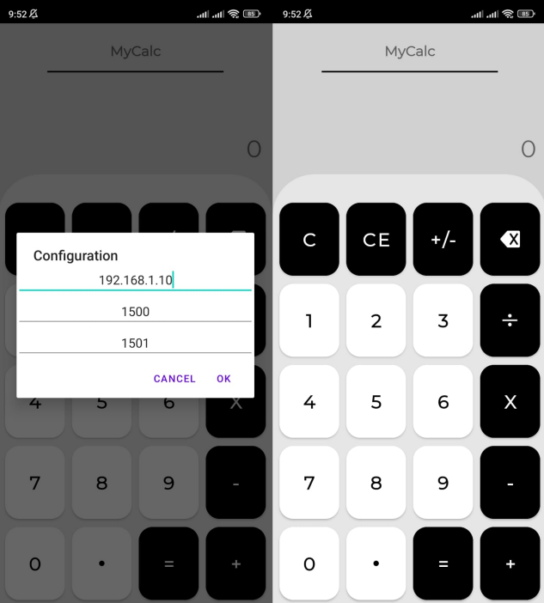
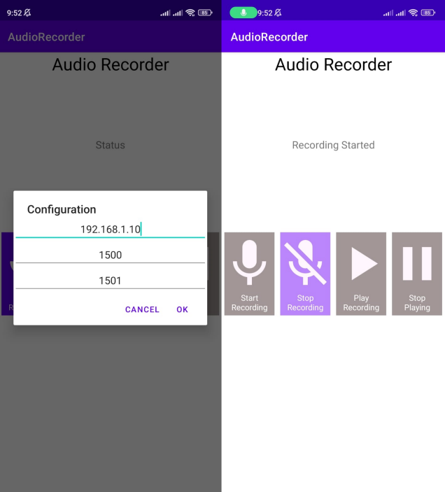
Test applications
Calculator
Audio recorder
13/07/2023
Mirco Venerba – Remote debugging detection in Android
25

Slide 28
Future developments
13/07/2023
Mirco Venerba – Remote debugging detection in Android
26

Slide 29
Some future developments
Unique identifier of the device
Reprojection all functionality in the same and native package
In-depth study of settings file to understand which is the most suitable combination for all configuration variables
Improvement of the training phase using machine learning algorithms
Implementation of 1 to n model in the web server
13/07/2023
Mirco Venerba – Remote debugging detection in Android
27

Slide 30
Conclusions
Developed a High-level novel complex project
Why novel?
First tool that brings together so many different types of data
Why high-level?
Tool that uses an incremental security level base on 10 different red flags
Why complex?
There are too many possible different configurations for each red flag
13/07/2023
Mirco Venerba – Remote debugging detection in Android
28

Slide 31
Thanks for the attention

Slide 32
Related work
MATE attacks
Obfuscation, e.g. the modification of the code / flow of execution
Device attestation, e.g. device properties verified and not counterfeit
Dynamic code renewability, e.g. a tool chain capable to modify code
Self debugging, e.g. connected debugger to occupy the unique free position
Anomaly detection
Static analysis (ProfileDroid), e.g. code that acquire and communicate sensitive data
Dynamic analysis (TaintDroid), e.g. various levels of abstraction
Download external resources (DroidTrace), e.g. check resources from a remote server
Sandboxing (Aurasium), e.g. application inside a bubble
13/07/2023
Mirco Venerba – Remote debugging detection in Android
30

